Slide 1
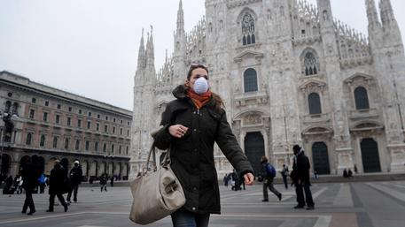
Predicting Air Pollution with Machine Learning Gabriele Pinto MADAS – Collegio Carlo Alberto

Slide 2




OUTLINE

Slide 3
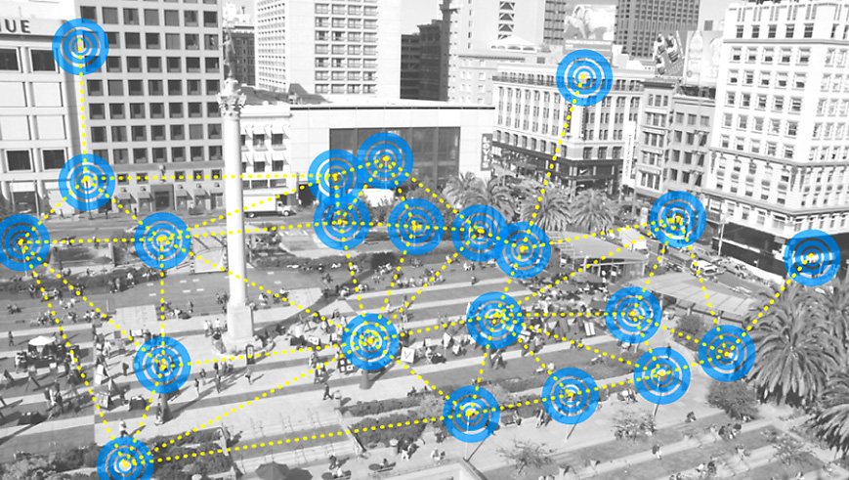
INTRODUCTORY DESCRIPTION OF THE DATA

Slide 4



What data we have
41,288 (~40k) observations from pollution sensors (daily and hourly)
9,183,475 (~9 million) observations from traffic sensors (with timestamp)
39, 167 (~40k) observations from weather sensors (hourly)

Slide 5


Where and When ?
MILAN (Italy)
2 Months (between 01 Nov 2013 and 31 Dec 2013)

Slide 6


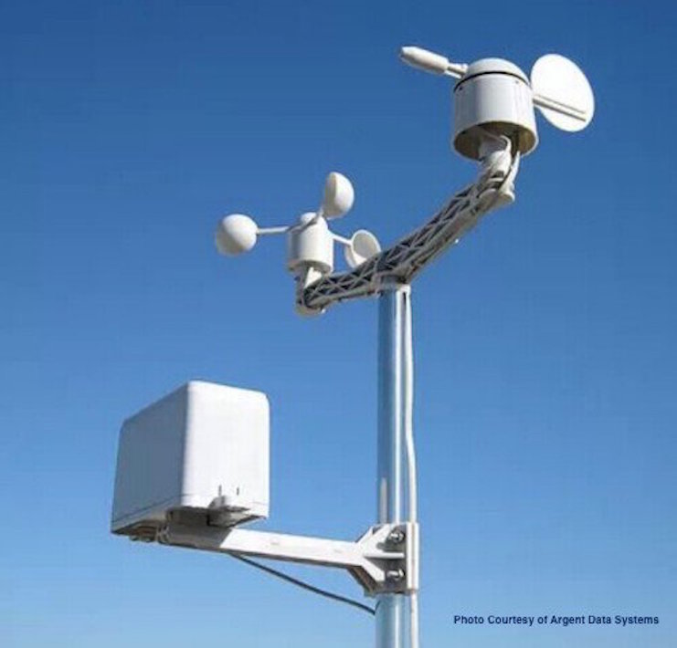
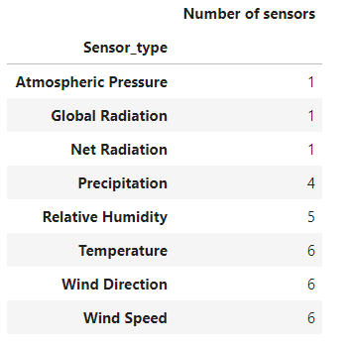
Weather Sensors
Features
Unit measurement
Value of the measurements
Location

Slide 7
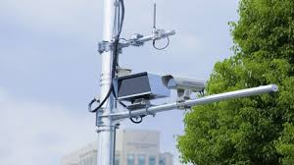
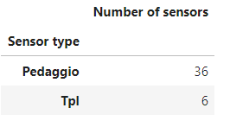
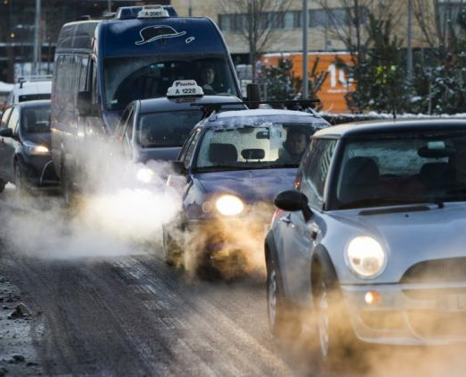
Traffic Sensors
Features:
Detailed information on type of vehicle coming from the matching of the palette with the “motorizzazione civile” dataset:
Size of the vechicle (width)
Engine ( diesel, oil, electric…etc)
Environmental class (euro 0,1 ..5 etc)
Location

Slide 8
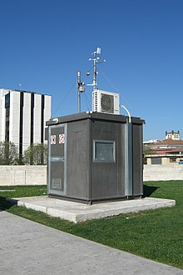
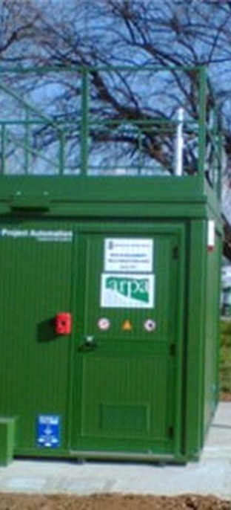
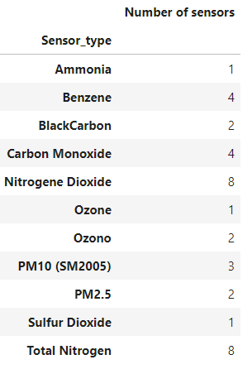
Pollution sensors
Features
Unit measurement
Value of the measurements
Location

Slide 9
CONTEXT AND OBJECTIVES

Slide 10



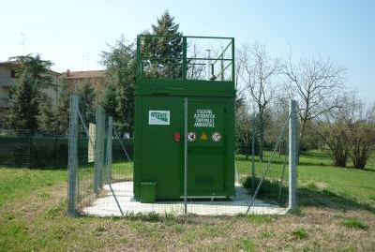


PROBLEM
Pollution sensors are costly!
And not real- time available.
While traffic and weather data are much less costly and are already adopted for other uses.
Thus, it might be a good idea to use traffic and weather sensors to predict pollution…..
Furthermore…..

Slide 11

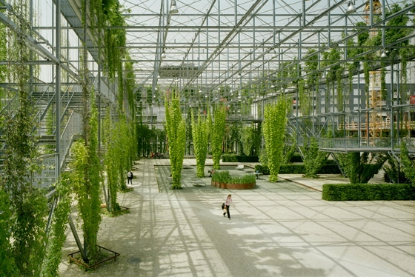
Pollution predictions could be useful for..
Inform policymakers to:
Adopt preventive actions
Policy planning
and……
Make better informed decisions for (hopefully) Greener city!

Slide 12
Objective of the modelling task:
MODEL
INPUT
INPUT
Using Weather and Traffic Sensors to predict Pollution !

Slide 13

DATA PRE-PROCESSING

Slide 14

Data aggregation
Problem is that our data are heterogeneous in terms of time and space.
As a solution we aggregate all the data on hourly observations
While we average sensors based on their type (for pollution and weather only). And we add up information from traffic sensors.

Slide 15
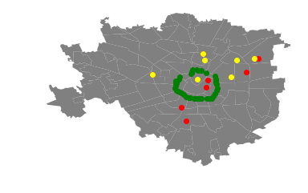
Sensors Location
Pollution Sensors
Traffic Sensors
Weather Sensors

Slide 16
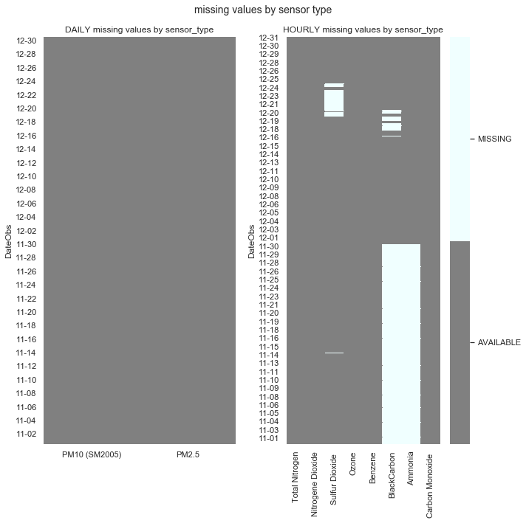
Data imputation
We have several missing values in the pollution dataset we decide to impute using random forest.

Slide 17
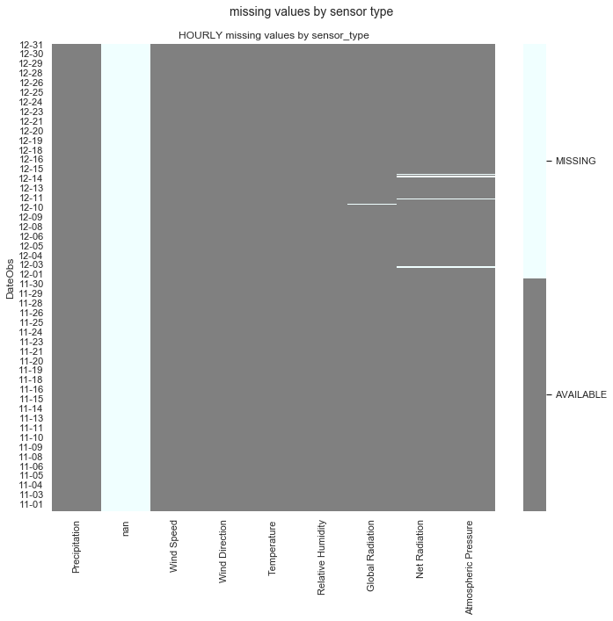
Data imputation
The weather dataset has only few missing values we impute as well using random forest. We also have a sensor for which no obs neither details are available (we decide to drop it from the dataset).

Slide 18
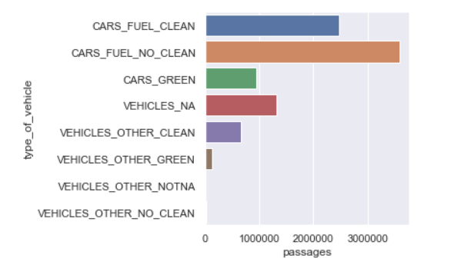
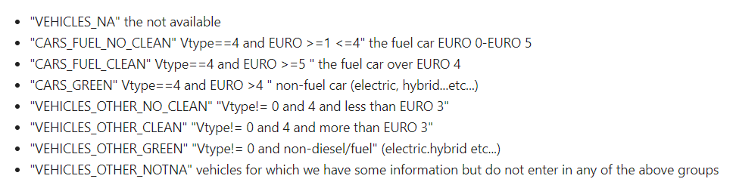
Features Selection in the Traffic Dataset
Grouping type of cars

Slide 19
Other Features enginnering
We end up with 18 Features
To which we add:
Exponentially Smoothed variables (+ 18 features)
24 Hours var (ratio var between 0 and 24)
Number of the day in the week (ratio var from 0 to 7)
Weekend dummies (0-1)
For a total of 36 features and 1464 observations

Slide 20
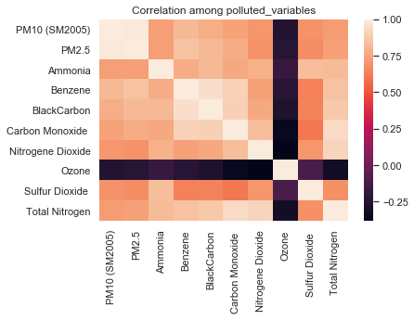

Slide 21
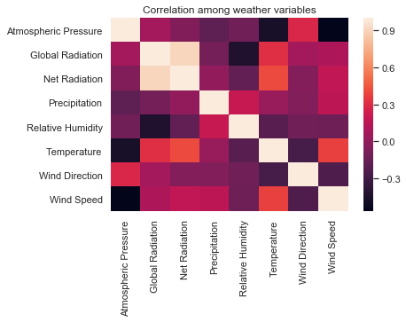

Slide 22
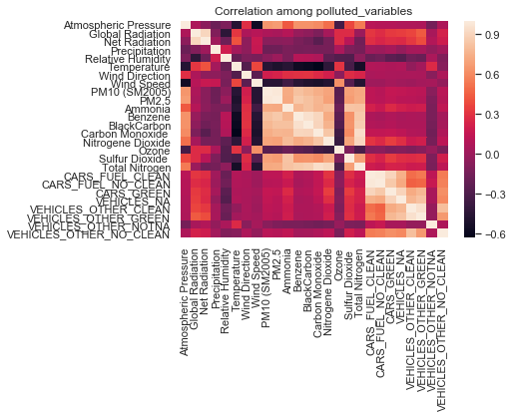

Slide 23
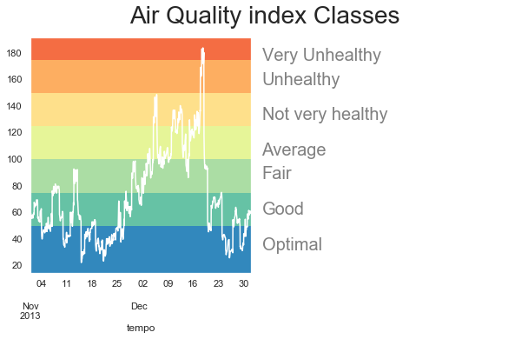
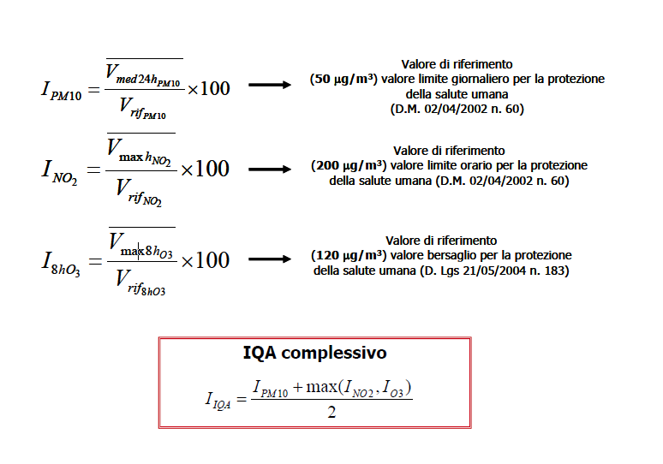
Adapted to hourly!

Slide 24

RESULTS

Slide 25

But which model we should use ?
We opt for different models that include “auto” feature selections (or shrinking parameter that take into account var importances…)
Ridge
Random Forest
Support Vector Machine
Neural Networks
n.b.: -we use random sampling with test size 20% (limitations discussed in last slide)
-no big gain from stratifies sampling (not reported here)

Slide 26
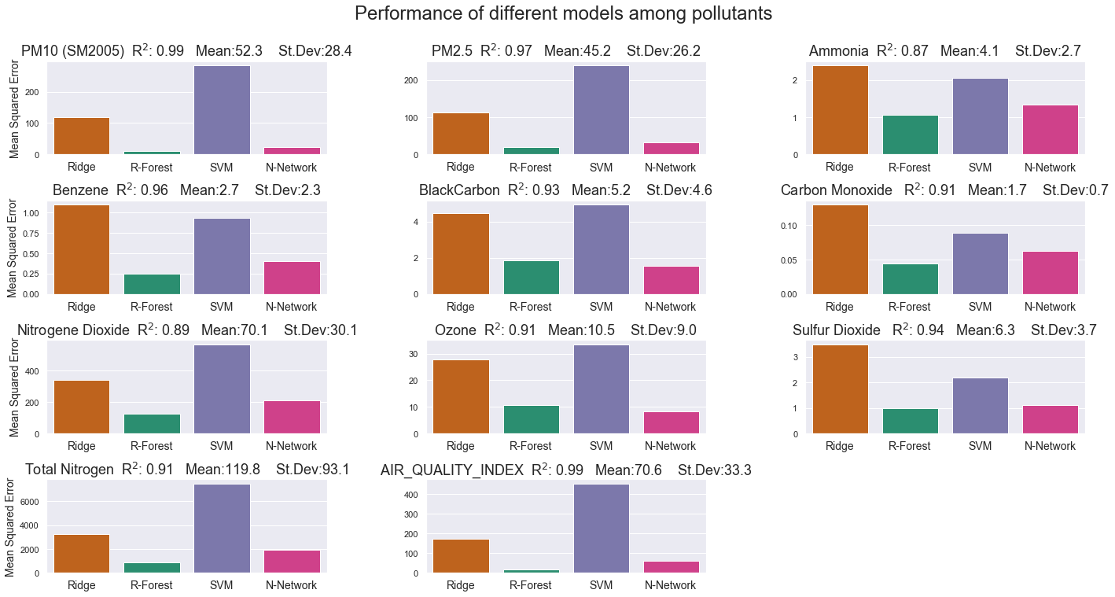
RANDOM FOREST SIGNIFICANTLY PERFORM BETTER !
n.b. hyperparameter calibration might change this figures…

Slide 27
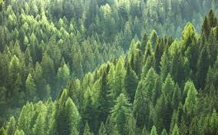

A RANDOM FOREST

Slide 28
Approaches to predict Air Quality Index
1
“LA COMPLICATA”
Predict pollutants and then compute the corresponding AQI (using also “training” obs , since sampling is randomized).
2
“LA DIRETTISSIMA”
Predict directly AQI
3
“LA SEMPLICE”
Predict AQI classes using AQI scores
4
“LA CLASSICA”
Classify AQI classes (Classification Task)

Slide 29
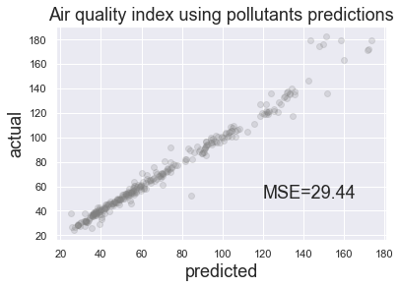
“LA COMPLICATA”
We take results from the pollutants predicted by random forest… and then compute the implied AQI
n.b. please note that this way we also use obs from the test set to compute AQI

Slide 30
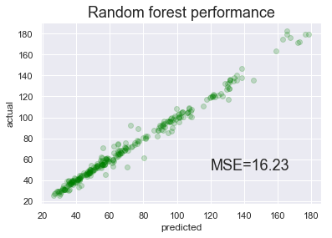
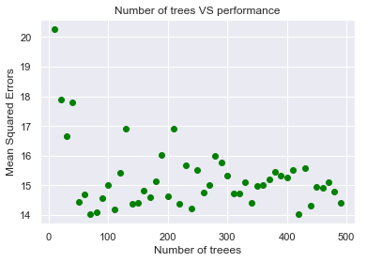
“LA DIRETTISSIMA”
We predict directly the AQI using Random Forest. (with 100 trees).

Slide 31
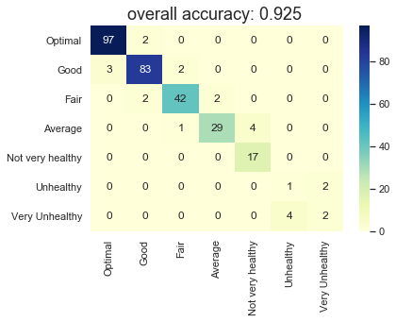
“LA SEMPLICE”
We use the results from a Random Forest Regressor, to compute the corresponding labels.
(i.e. rows are actuals, columns are predicted)
Benchmark is ~0,35 (frequency of “optimal)

Slide 32
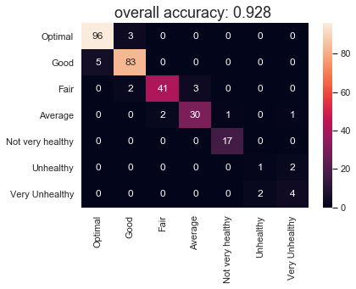
“LA CLASSICA”
We predict the class using a Random Forest Classifier.
Results are quite similar as before.
(i.e. rows are actual, columns are predictions)

Slide 33
Summing up…..
We manage to get:
MSE: ≈15 (benchmark 1100)
ACCURACY: ≈ 92% (benchmark 35%)
Everything nice BUT…

Slide 34

Some important limitations
The results we show cannot be properly interpreted as “out of sample” test errors for several reasons:
In the imputation phase we used all the variables (both from train and test set).
Smoothed variables incorporate info from both test and train set
To get appropriate estimates for the performance of the model, the test should be sampled considering time constraint of the variables (i.e. should be taken from a period of observations after the train set).
Test error is the error you get when you run the trained model on a set of data that it has previously never been exposed to. This test error can be used to estimate the accuracy of the model before it is shipped to production.

Slide 35


